Slide 1
Robots ?
http://www.youtube.com/watch?v=Z_Tb6SCTyy8
http://www.youtube.com/watch?v=odMM2rlR0L8
http://www.youtube.com/watch?v=1OGTzw3eQUk

Slide 2
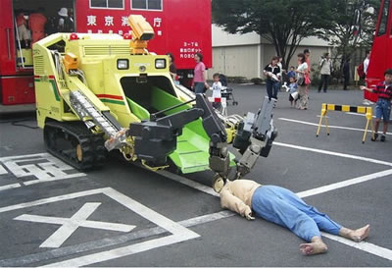
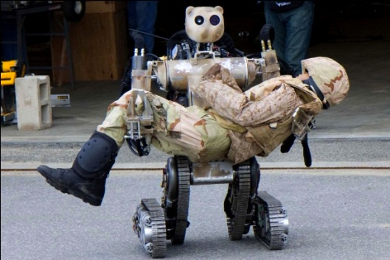
Rescue robots

